Slide 1
Image Restoration
Wang JiaoTuan
2010. 1.21

Slide 2
Contents
1
Introduction
2
Degradation Model
3
Noise Model
4
Restoration Algorithms
5
Result

Slide 3
What Is image restoration?
A process that attempts to reconstruct or recover an image that has been degraded by using some prior knowledge of the degradation phenomenon.
Many factors can cause the degradation of the image during the image acquisition. Such as noise of sensor, not focus of camera, object movement , object illumination, light scatter.

Slide 4
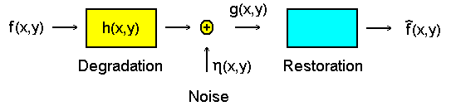
Introduction
The goal of image restoration is to improve a degrade image in some predefined sense. Schematically this process can be visualized as
where f is the original image, g is a degraded version of the original image and f ̃ is a restored version.

Slide 5
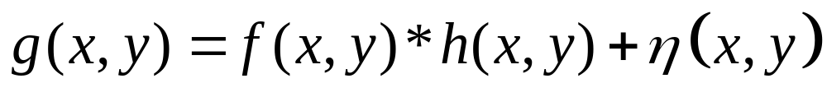
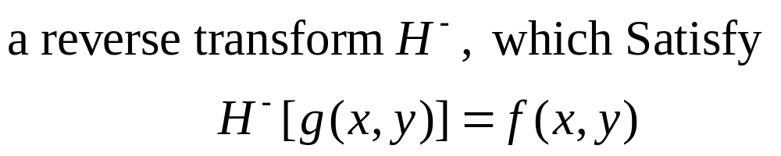
Degradation Model
Math Representation:
Derivation:
So, Blurred Image Restoration’s goal is to find

Slide 6
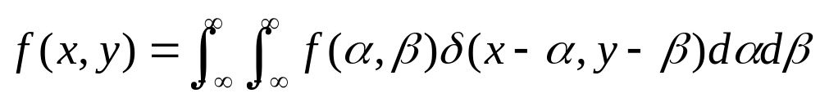
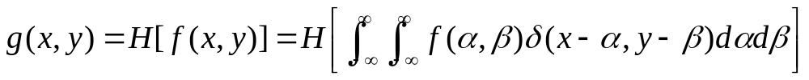
Degradation Model
According to the define of Impulse function:
impulse

Slide 7


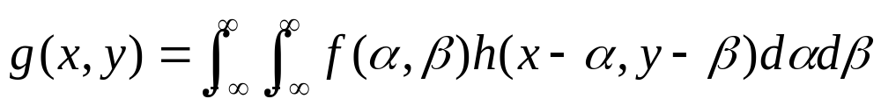

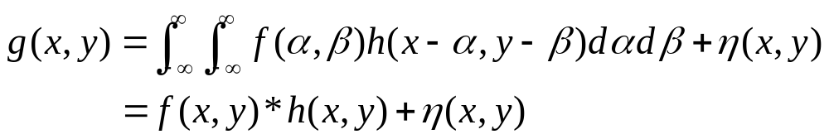
Degradation Model
Impulse response (point spread function)
If position-invariant

Slide 8
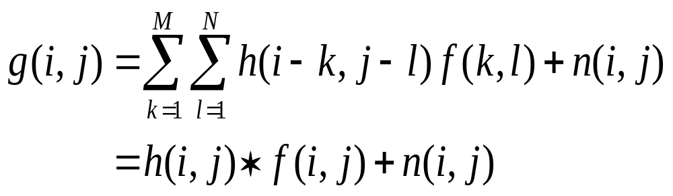
Degradation Model
the discrete degradation model is:
f(i, j)：Original Image
g(i, j)：degraded Image
h(i, j; k, l)：PSF (Point Spread Function)
Dimension of Image is M×N.

Slide 9
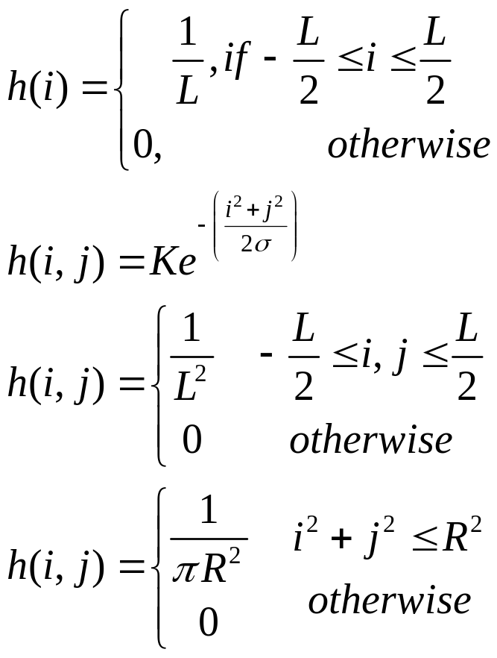
Degradation Model
Image degradation can occur for many reasons, some typical degradation models are:
Motion Blur: due to camera panning or subject moving quickly.
Atmospheric Blur: long exposure
Uniform 2D Blur
Out-of-Focus Blur
Very useful

Slide 10
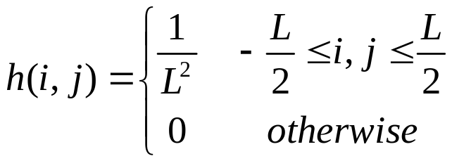
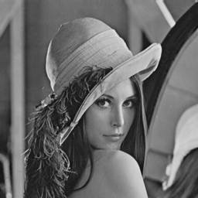
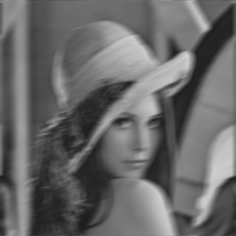
Degradation Model
Motion Blur:
Original Image
Blurred Image

Slide 11
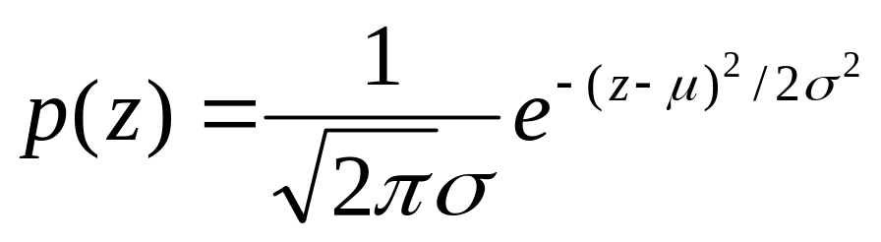
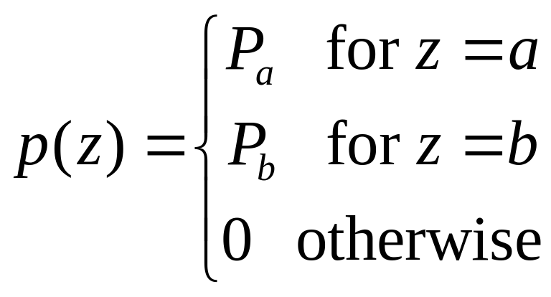
Noise Model
Most noise models assume the noise is some known probability density function. The density function is chosen based on the underlining physics.
Gaussian:
Salt and
Pepper:
In practical, a=0(black) and b=255(white)

Slide 12

Noise Model
Gaussian:
Original Image
Gaussian Image

Slide 13

Noise Model
Salt and Pepper:
Original Image
Salt and Pepper Image

Slide 14
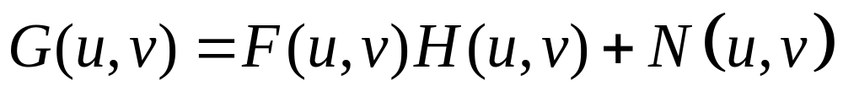
Restoration-Inverse Filter
Assume the image system in spatial domain:
After the FFT, In the frequency domain, we have
where G(u,v) and F(u,v) are the Fourier transforms of
the degraded image g(x,y) and the input image f(x,y), respectively. H(u,v) is called the degradation function, and N(u,v) is a noise term.

Slide 15
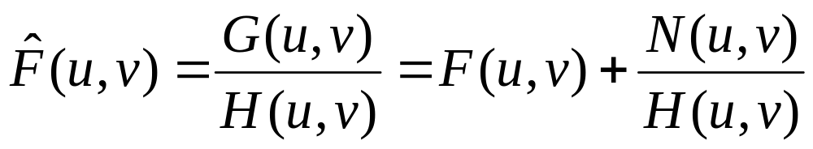
Inverse Filter
With the estimated degradation function H(u,v)
Unknown
noise
=>
Estimate of
original image
Problem: 0 or small values

Slide 16



Inverse Filter
Original Image
Degraded Image
Inverse Filter Image
the result is absolutely terrible!

Slide 17
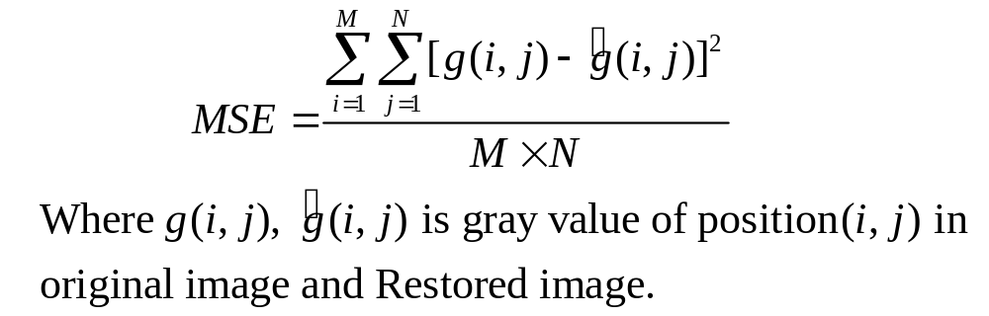
Wiener Filter
To overcome the noise sensitivity of the Inverse Filter, a collection of least squares filters have been developed. The Wiener Filter is a linear, spatially invariant filter which is chosen to minimize the MSE between the original and restored image.

Slide 18
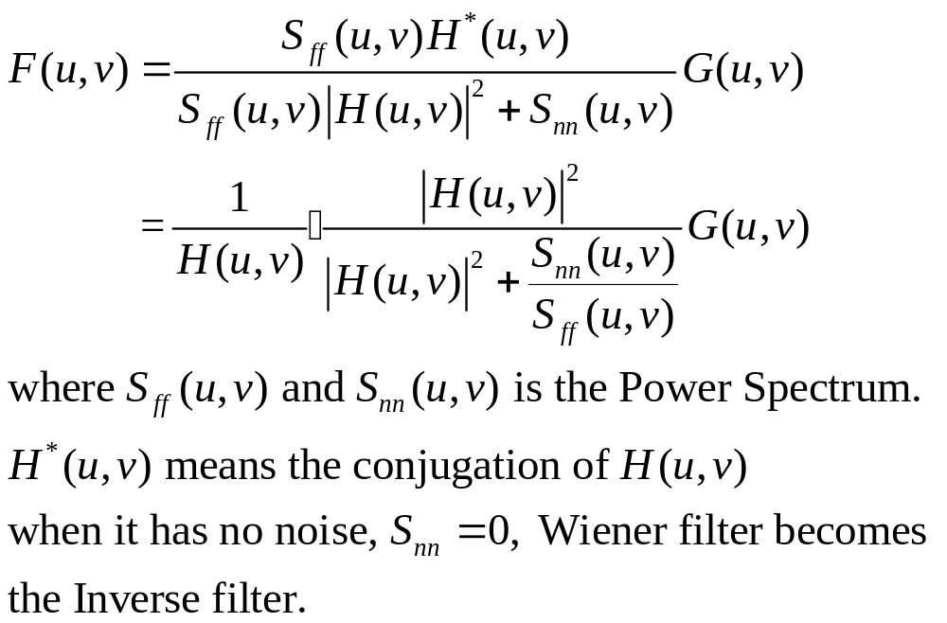
Wiener Filter
So, In frequency domain, we have

Slide 19
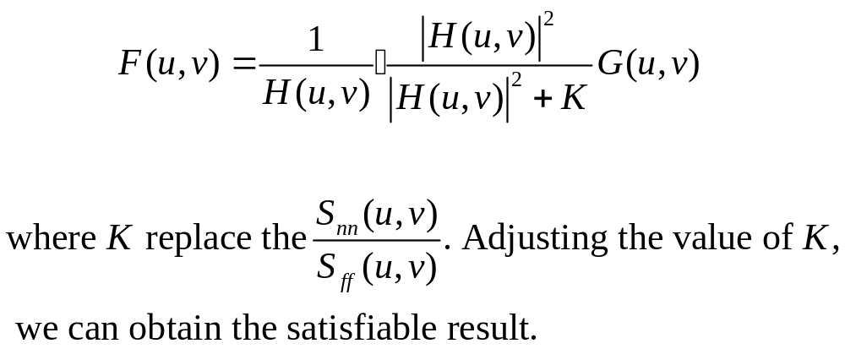
Wiener Filter
In practice:

Slide 20

Wiener Filter
Original Image
Degraded Image
Wiener Filter Image
The result is much better than Inverse Filter. Wiener Filter is used widespread, because of its good effects in restoration with less computational cost and resistance of noise.

Slide 21
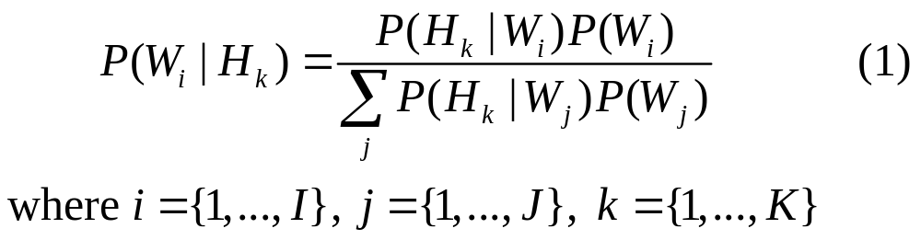
Lucy-Richardson
Given the degraded image H, the point spread function S, and the requirement to find the original image W, Bayes's theorem comes readily to mind. In the notation of this problem the usual form of the Bayes's theorem' may be stated as the conditional probability of an event at Wi given an event at H_{k} ,
where H_{k} is for the moment an arbitrary cell of H.

Slide 22
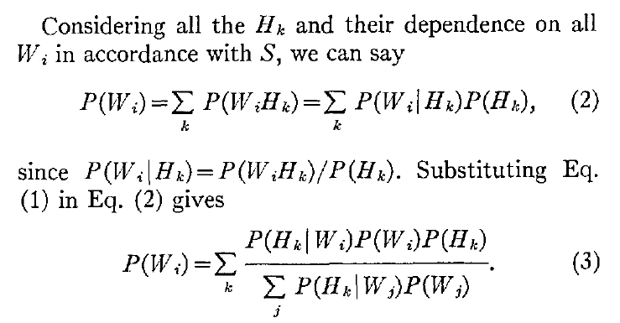
Lucy-Richardson

Slide 23
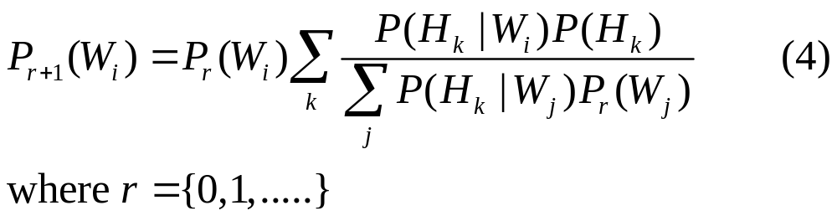
Lucy-Richardson
The Eq(3) can becomes:
This results in an iterative procedure where the initial
P₀(W_{i}) is estimated.

Slide 24
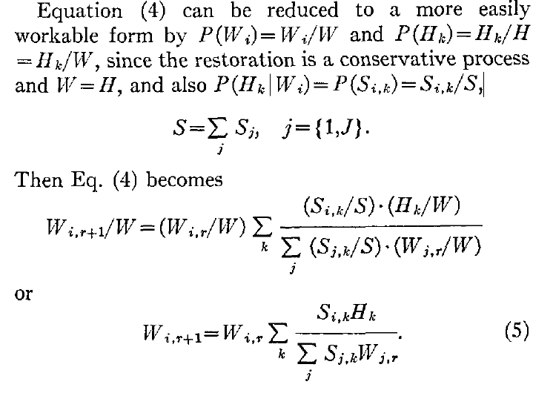
Lucy-Richardson
Lucy-Richardson

Slide 25

Lucy-Richardson
Original Image
Degraded Image
Lucy Richardson
50 Iterations

Slide 26

Result
Algorithm comparison
Original Image
Degraded Image
Wiener Filter Image
Lucy Richardson
50 Iterations
Lucy Richardson
200 Iterations

Slide 27




Result
Algorithm comparison
Original Image
Degraded Image
Wiener Filter Image
Lucy Richardson
50 Iterations
Lucy Richardson
200 Iterations

Slide 28



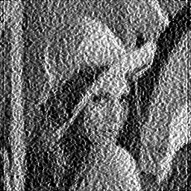
Result
Algorithm comparison
Original Image
Degraded Image
Wiener Filter Image
Lucy Richardson
50 Iterations
Lucy Richardson
200 Iterations

Slide 29
Algorithm Comparison
 | Wiener | L-R (50 Iterations) | L-R (200 Iterations)
Merit | Little cost, good result for non-noise image | good result for image | better result for image
Drawback | Little bad handle for noise image | Cost is a little higher | Cost is more higher than Wiener
Notes:
For image “bibby” blurred by 20 pixels at 45 deg.
L-R clearly wins the quantitative comparison. How about the visual comparison?

Slide 30
Thank You!

